Slide 1
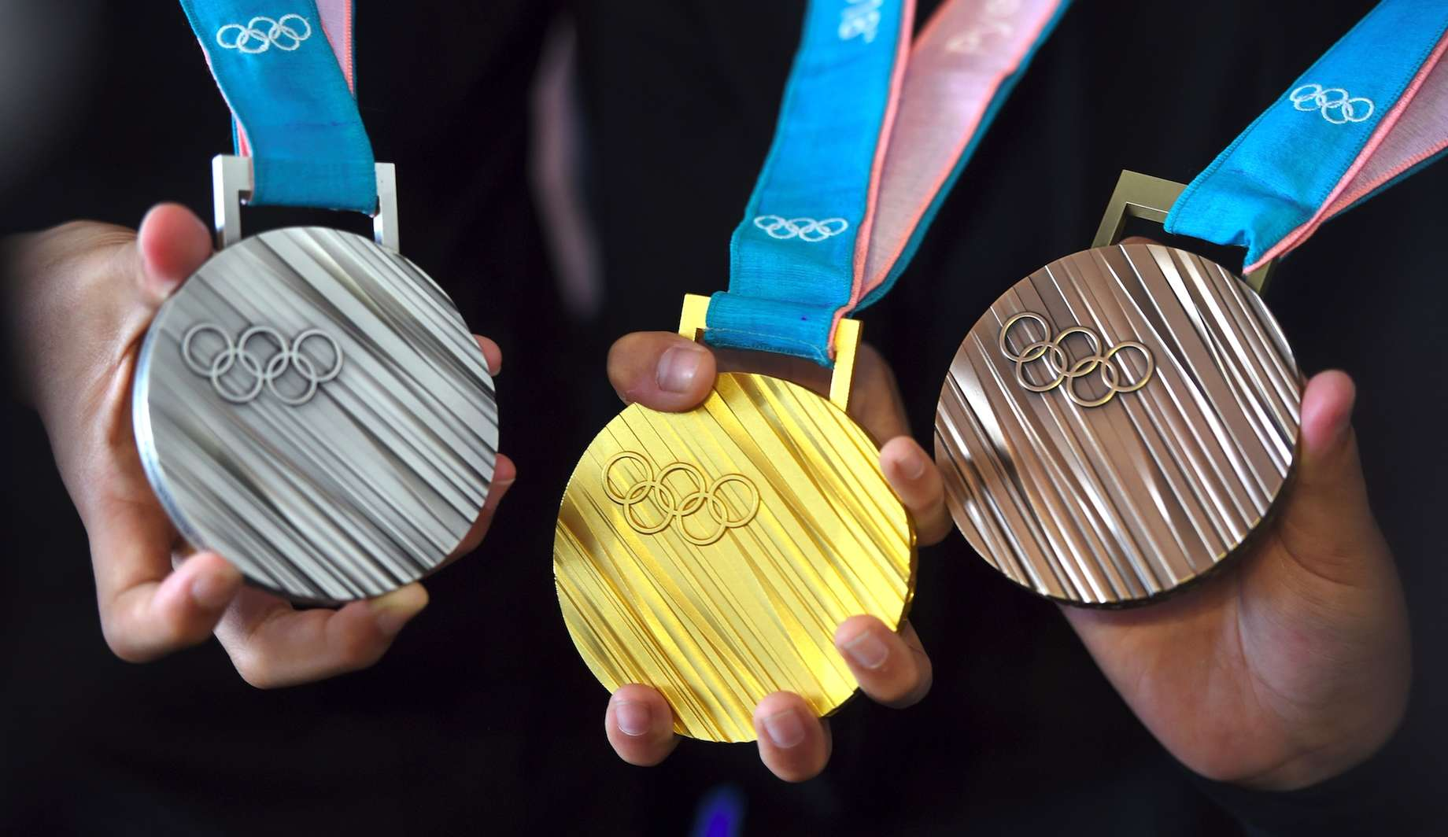
Aim:
To Transform and Analyze the Olympic Data set converting into a practical implementable data model using the appropriate technologies.
Steps:
Data Cleaning
Data Modelling
Data Loading
Data Analysis
Technologies Used:
ETL Tool- Talend
Apache Hive
Data bricks

Slide 2
INTRODUCTION ABOUT DATASET
It contains details of every event held and the athletes who competed.
Each athlete has a unique ID number, with some athletes participating at multiple events and across different olympics.
The full dataset consists of 271,116 rows and 15 columns.The columns consist of: athlete ID, name, gender, age, height, weight, team, national olympic committee 3-letter code, name of games, year held, season, host city, sport, event, and medal won.
Missing data or if an athlete failed to win a medal are stored as NA.

Slide 3
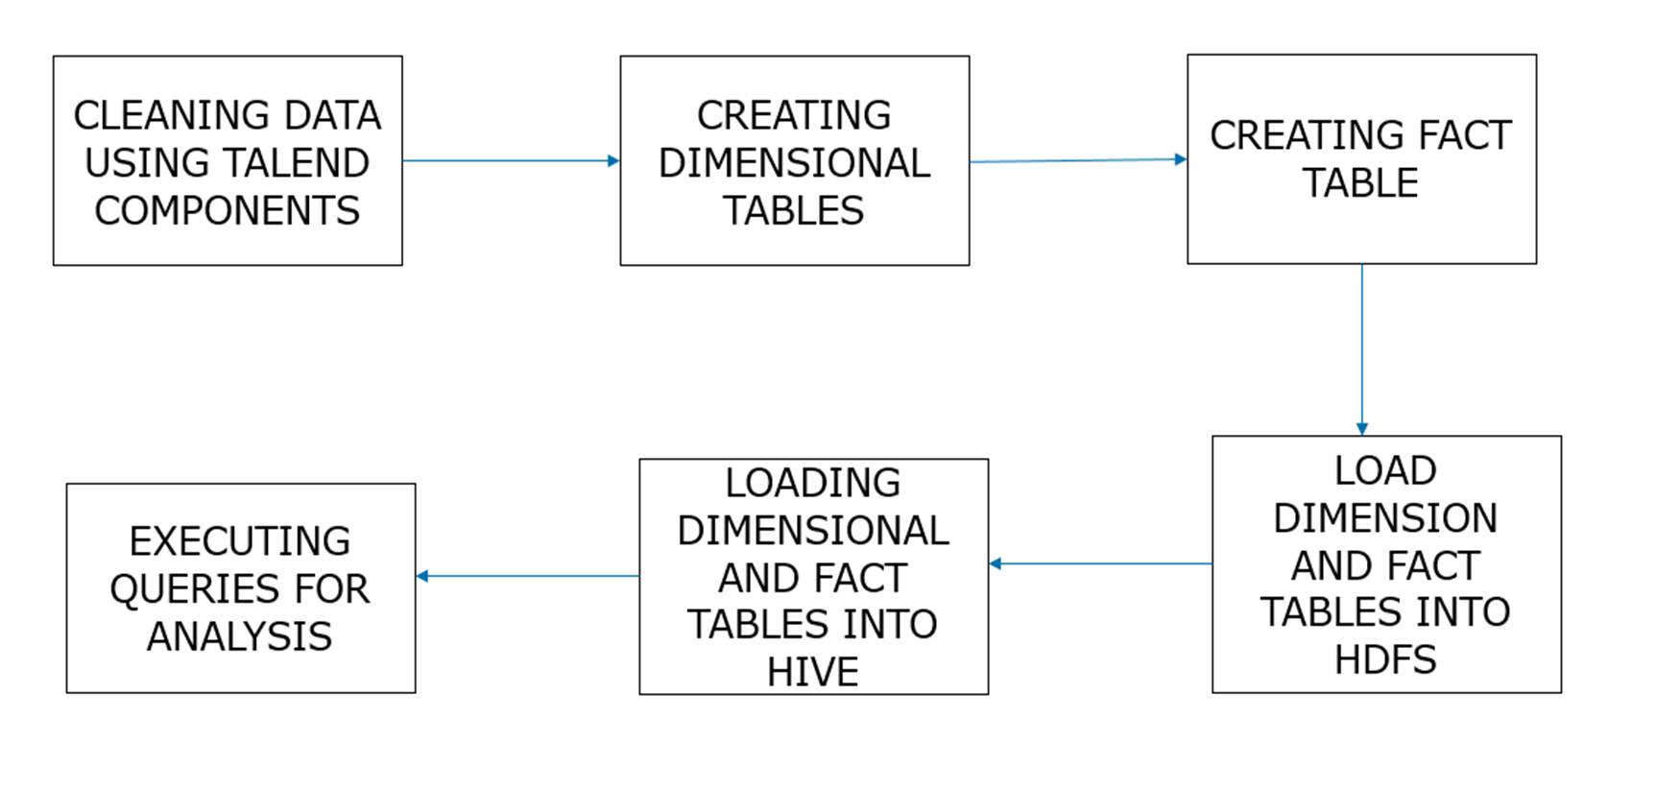
Work Flow

Slide 4
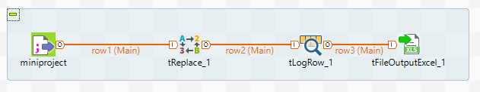
Data Cleaning

Slide 5
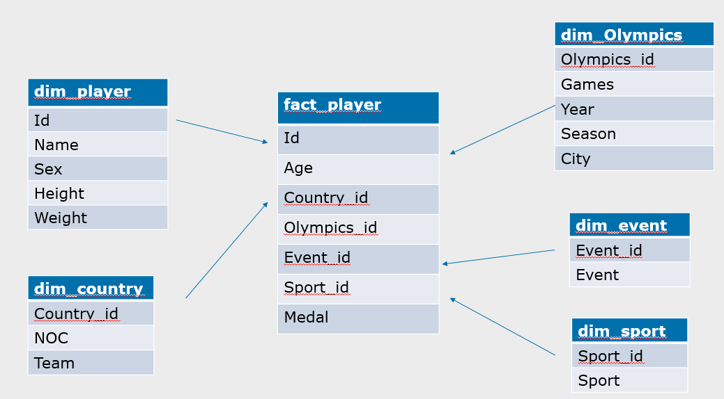
Data Model

Slide 6
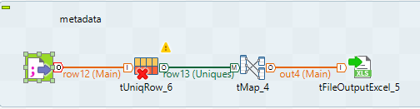
Creating Dimensional Tables

Slide 7
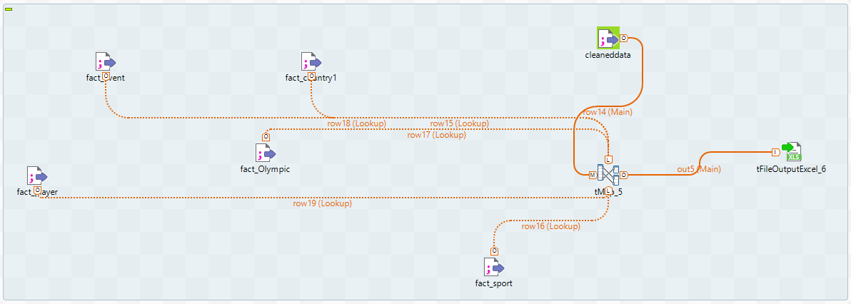
Creating Fact Table

Slide 8
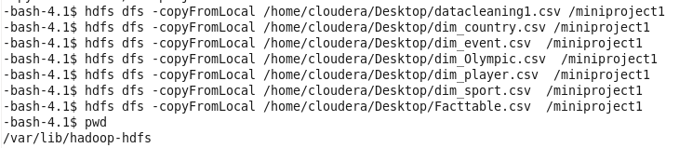
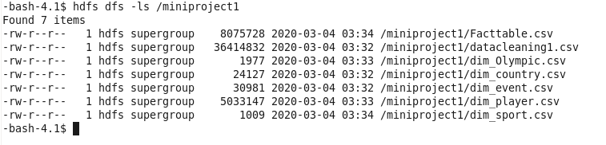
Loading Data into hdfs

Slide 9

Creating Tables in Hive

Slide 10

Loading Data into Hive

Slide 11

Analysis of Data
1.How many gold has a particular country won till date?
Output:

Slide 12
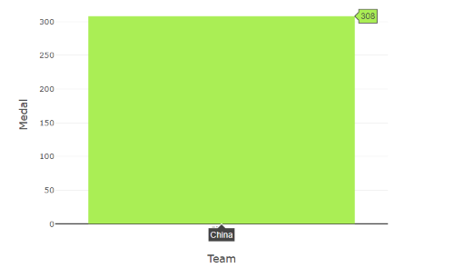
Graph represents how many gold medals are won by china

Slide 13
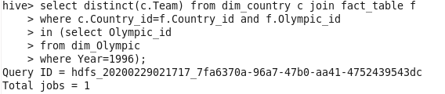
2.List of all countries who had participated in a particular year?

Slide 14
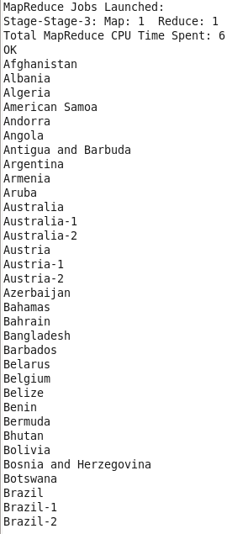
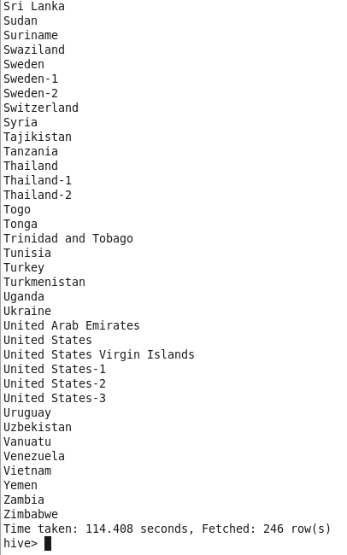
Query output

Slide 15
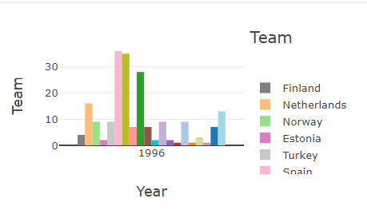
Graph represents the countries who participated in particular year

Slide 16
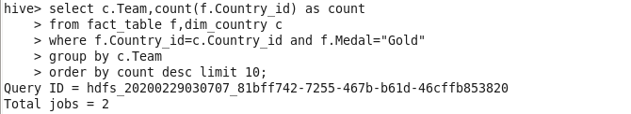
3.Top 10 countries who have won gold?

Slide 17
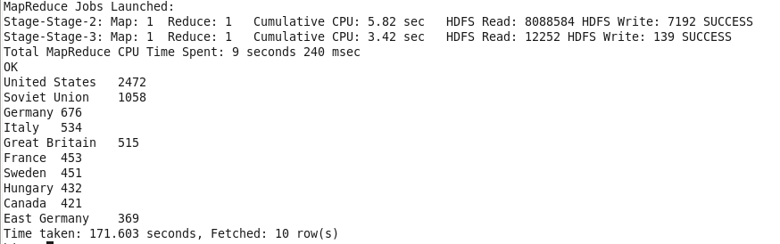
Query Output:

Slide 18
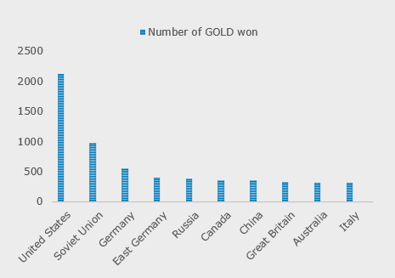
Graph represents top 10 countries who have won gold

Slide 19
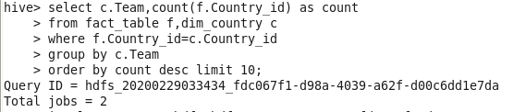
4.Top 10 countries , who have participated in Olympics the maximum time

Slide 20
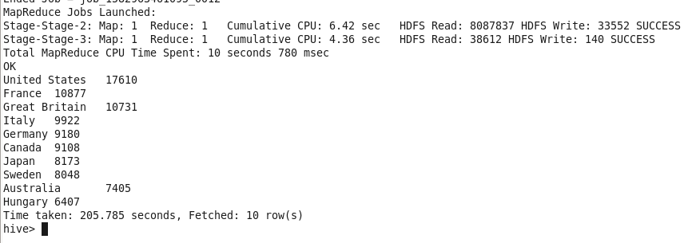
Query output :

Slide 21
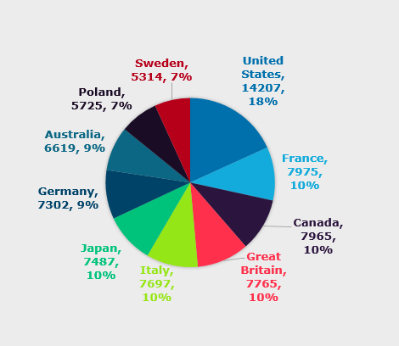
Graph represents top 10 countries who have participated in Olympics the maximum time

Slide 22


